Slide 1
Internship Challenge
By: Kevin Quach

Slide 2
Topics
1. What is the issue?
2. Why is the cause important to me?
3. My solution to the issue

Slide 3
Topic 1
What is the Social Issue?

Slide 4


Lack of Education in Developing Nations
59 million children in developing countries do not have access to basic education
Children in developing nations face many barriers
Unsafe schools
Poor quality of teaching
Fees family are unable to afford

Slide 5
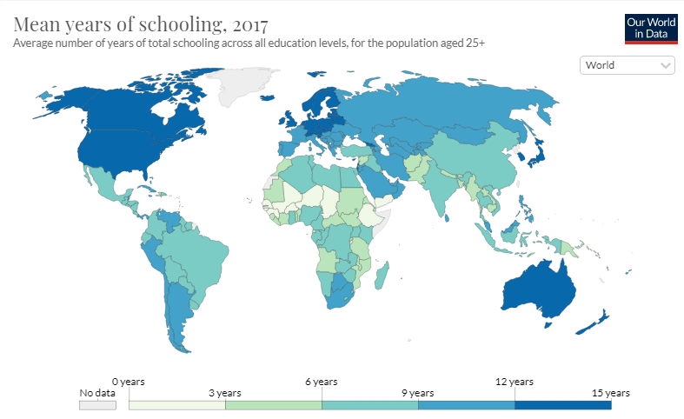
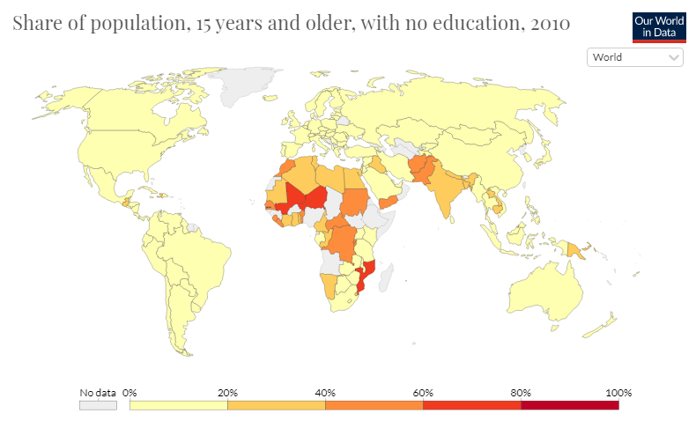
To Paint the Picture Graphically
Developing nations have dramatically lower education provided

Slide 6
Topic 2
Why is this Important to me?

Slide 7
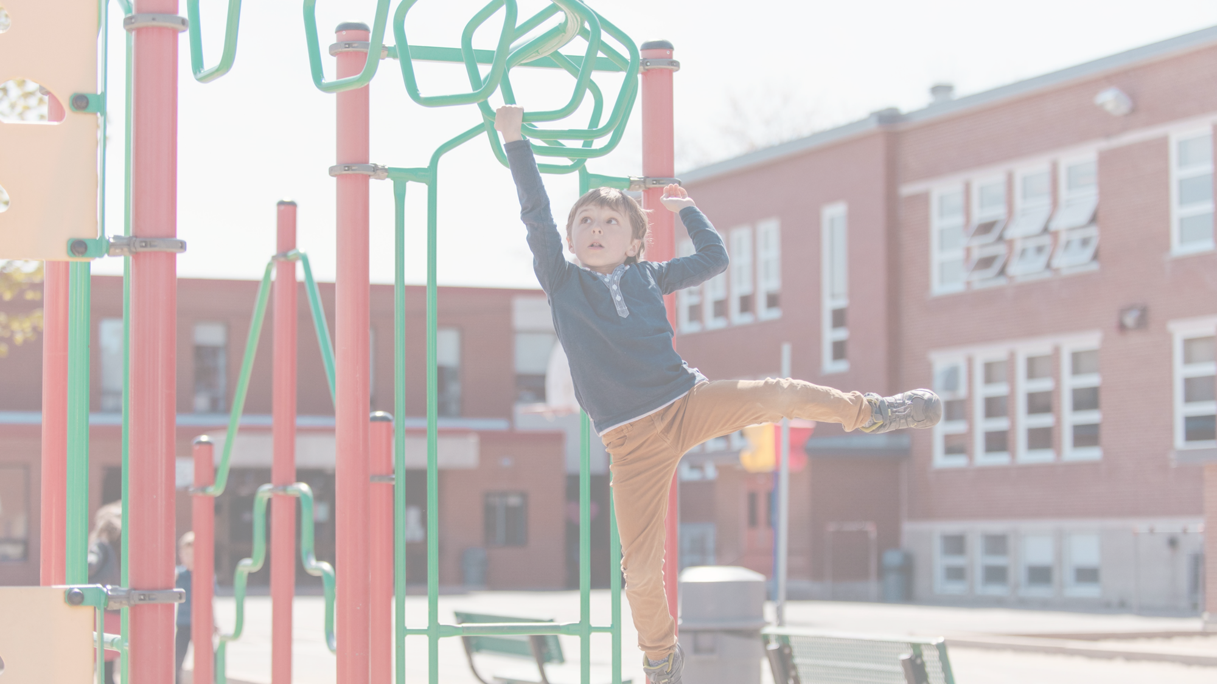
“Education is not a way out of poverty, it is a way of fighting it”
Julius Nyerere
10/21/2020

Slide 8
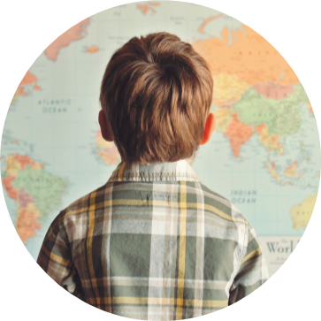
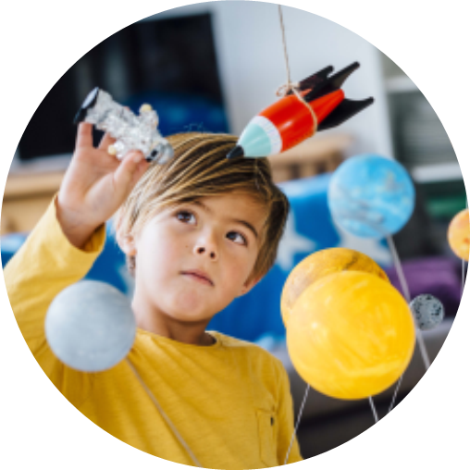
Education and Poverty Cycle
No Education
No Opportunities
A lack of basic education means no good foundation
No foundation results in a lack of opportunities for income
Poverty
Adults have families with a lack of income restarting the cycle
Topic 2. Why is this Important to me?

Slide 9
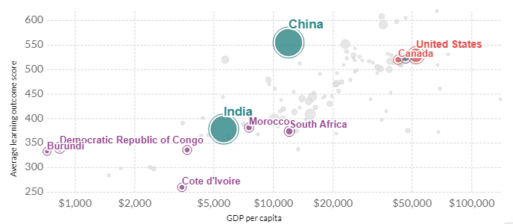

Education’s Positive Impact
The graph to the right illustrates education’s positive impact
When citizens in a country are more educated the overall wealth of the country goes up
This means that investing in education in developing nations, more families can be lifted out of poverty
“Education is the most powerful weapon which you can use to change the world.”
Topic 2. Why is this Important to me?

Slide 10
Topic 3
My Solution to the Issue

Slide 11
Barriers in Providing Education
Untrained Teachers
Lack of Quality Classrooms
Lack of Learning Materials
Teachers are the most important predictor of student learning
Developing nations lack trained teachers
Result of this children go without learning basic math, writing, and reading skills
Classrooms are often overcrowded in developing nations
Schools can be falling apart, unsafe, and lack basic facilities
Distance from home and school may be too far
Learning in school is useless when it isn’t being reinforced
Learning materials are in short supply
Learning materials are often outdated or worn out

Slide 12
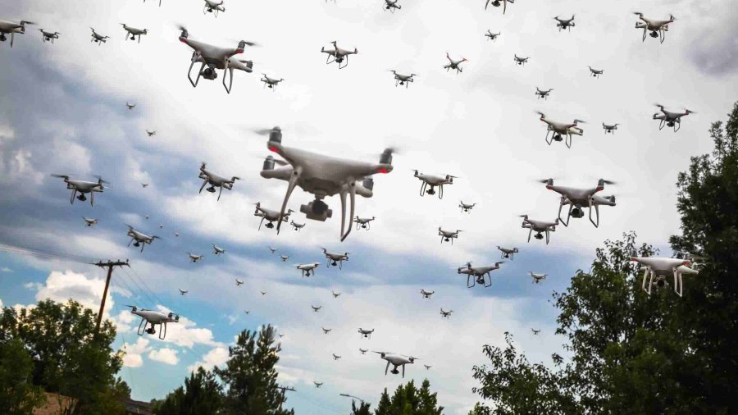
My Solution: If Packages can Fly, Education can Soar

Slide 13

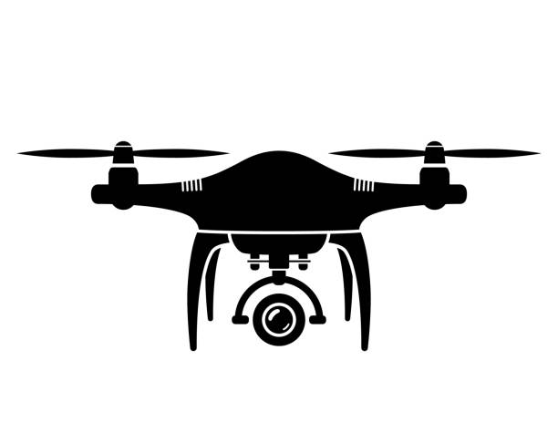
Use of Drones in Providing Children Education
Run Down of the Idea:
If you attach projectors and webcams to drones then you can project videos onto many places form far away
Then you can fly the drones to communities to teach basic reading, math, and writing skills
Drones can also be used to deliver learning materials in a new way
A “new way” could be educational programs similar to shows like Dora the Explorer
Bi-monthly or monthly check-ins could be used to determine the effectiveness of said education

Slide 14
How does it Overcome the Barriers?
Untrained Teachers
Lack of Quality Classrooms
Lack of Learning Materials
Only one trained teacher is needed to teach materials
If drones can relay the same class to different communities than only one recording is needed
The only hurdle becomes how would one teach the materials through a video
By using drones to project video in communities children could have classrooms virtually anywhere
Children no longer have to travel vast distances to receive schooling
Schooling becomes safer as it is in the presence of safe communities
Learning materials can also be provided via video format
Video format may be similar to educational kid programs aired on the TV
With videos learning material can’t be worn out
Videos also enable materials to be easily shared unlike books

Slide 15



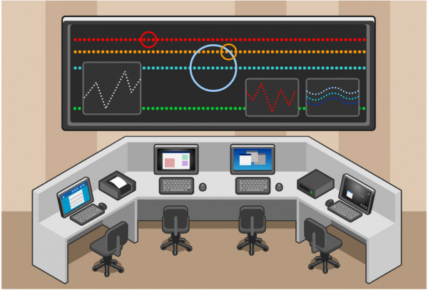


Overall Timeline
Begin by building a HUB where drones nest and information is gathered
This location should also be where learning curriculum is developed and created
1
Survey rural communities where formal education is lacking
2
Visit communities and communicate to everyone in the community how it is going to work
3
Fly out drones to determined communities to play footage
Fly out secondary drones to provide learning materials
4
Check-in on communities where drone is flown to and see progress
Adapt and change as necessary
Rinse and Repeat
5

Slide 16

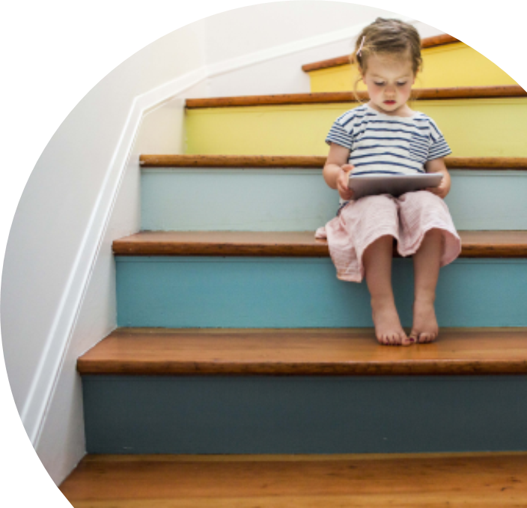
Summary
Education is important and vital to the growth and success of a nation. Many developing countries do not have the basic formal education needed to provide for children. This reduces the opportunities that children may have for the future, resulting in the education-poverty cycle.
With the use of drones and technology, basic education can be provided to virtually almost anywhere.

Slide 17
Thank you
How to Contact
Name: Kevin Quach
Email: kkquach@ualberta.ca
Sources:
https://www.international.gc.ca/world-monde/issues_development-enjeux_developpement/human_rights-droits_homme/education.aspx?lang=eng
http://documents.worldbank.org/curated/en/706141516721172989/Global-data-set-on-education-quality-1965-2015
https://www.globalcitizen.org/en/content/10-barriers-to-education-around-the-world-2/

